Slide 1
MODERN OPERATING SYSTEMS
Third Edition
ANDREW S. TANENBAUM
Chapter 7
Multimedia Operating Systems
Tanenbaum, Modern Operating Systems 3 e, (c) 2008 Prentice-Hall, Inc. All rights reserved. 0-13-6006639

Slide 2
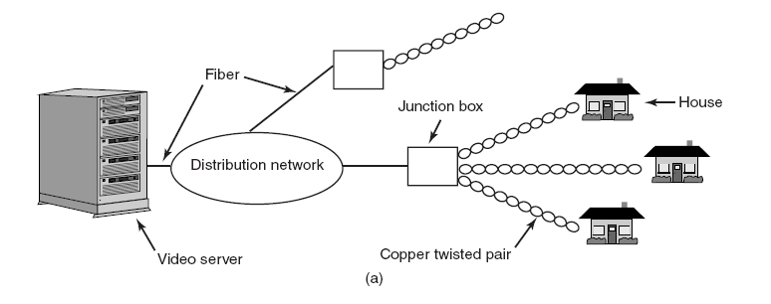
Introduction To Multimedia (1)
Figure 7-1. Video on demand using different
local distribution technologies. (a) ADSL.
Tanenbaum, Modern Operating Systems 3 e, (c) 2008 Prentice-Hall, Inc. All rights reserved. 0-13-6006639

Slide 3
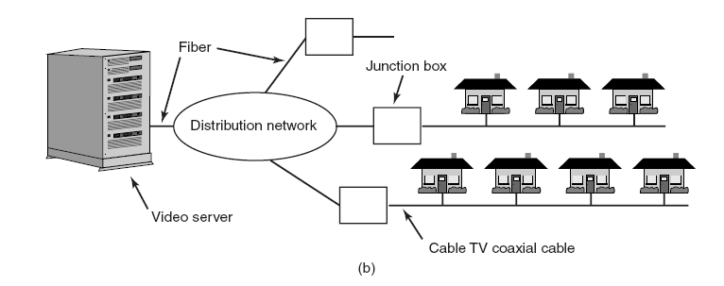
Introduction To Multimedia (2)
Figure 7-1. Video on demand using different
local distribution technologies. (b) Cable TV.
Tanenbaum, Modern Operating Systems 3 e, (c) 2008 Prentice-Hall, Inc. All rights reserved. 0-13-6006639

Slide 4
Introduction To Multimedia (3)
Key characteristics of multimedia:
Multimedia uses extremely high data rates.
Multimedia requires real-time playback.
Tanenbaum, Modern Operating Systems 3 e, (c) 2008 Prentice-Hall, Inc. All rights reserved. 0-13-6006639

Slide 5
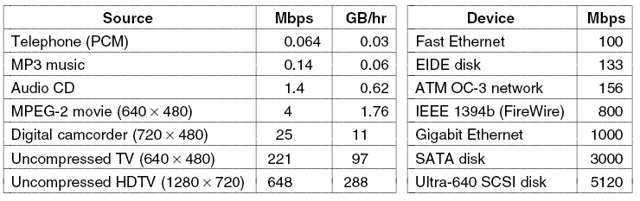
Introduction To Multimedia (4)
Figure 7-2. Some data rates for multimedia and high-performance I/O devices. Note that 1 Mbps is 10⁶ bits/sec
but 1 GB is 2³⁰ bytes.
Tanenbaum, Modern Operating Systems 3 e, (c) 2008 Prentice-Hall, Inc. All rights reserved. 0-13-6006639

Slide 6
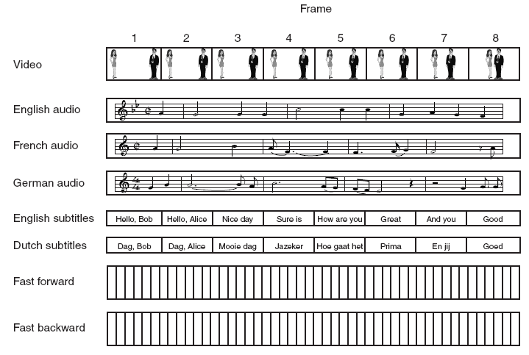
Multimedia Files
Figure 7-3. A movie may consist of several files.
Tanenbaum, Modern Operating Systems 3 e, (c) 2008 Prentice-Hall, Inc. All rights reserved. 0-13-6006639

Slide 7
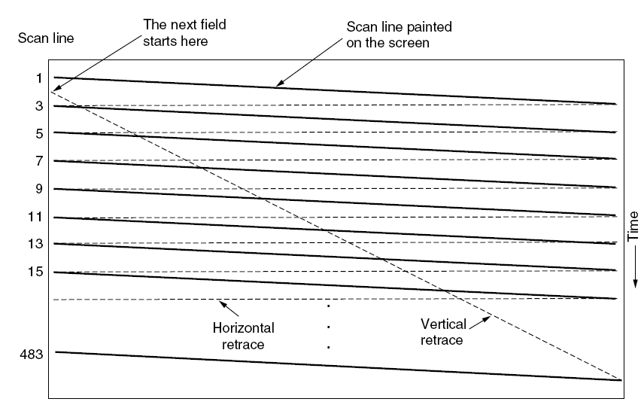
Video Encoding
Figure 7-4. The scanning pattern used for NTSC
video and television.
Tanenbaum, Modern Operating Systems 3 e, (c) 2008 Prentice-Hall, Inc. All rights reserved. 0-13-6006639

Slide 8
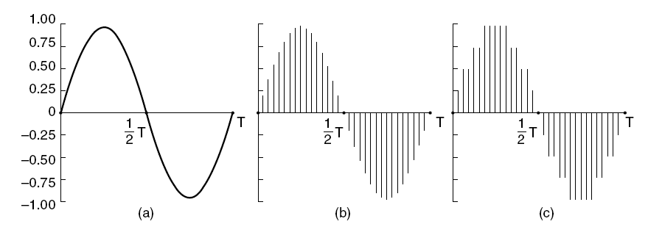
Audio Encoding
Figure 7-5. (a) A sine wave. (b) Sampling the sine wave.
(c) Quantizing the samples to 4 bits.
Tanenbaum, Modern Operating Systems 3 e, (c) 2008 Prentice-Hall, Inc. All rights reserved. 0-13-6006639

Slide 9
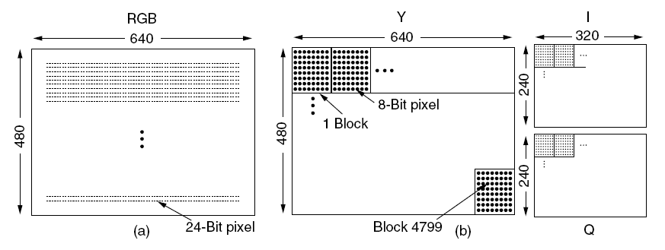
The JPEG Standard (1)
Figure 7-6. (a) RGB input data. (b) After block preparation.
Tanenbaum, Modern Operating Systems 3 e, (c) 2008 Prentice-Hall, Inc. All rights reserved. 0-13-6006639

Slide 10
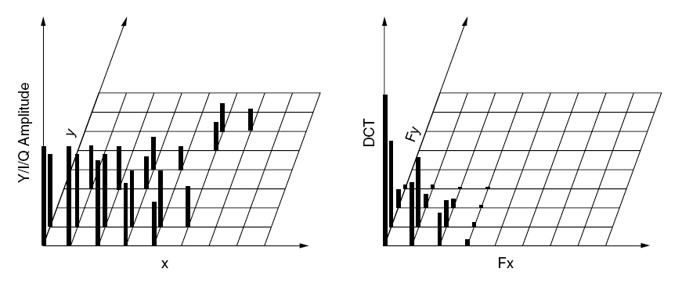
The JPEG Standard (2)
Figure 7-7. (a) One block of the Y matrix.
(b) The DCT coefficients.
Tanenbaum, Modern Operating Systems 3 e, (c) 2008 Prentice-Hall, Inc. All rights reserved. 0-13-6006639

Slide 11
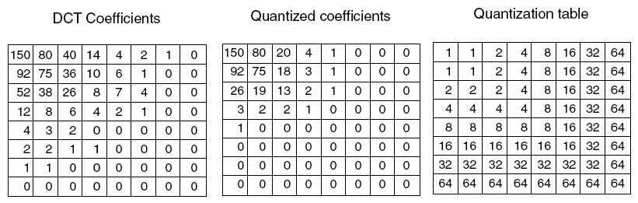
The JPEG Standard (3)
Figure 7-8. Computation of the quantized DCT coefficients.
Tanenbaum, Modern Operating Systems 3 e, (c) 2008 Prentice-Hall, Inc. All rights reserved. 0-13-6006639

Slide 12
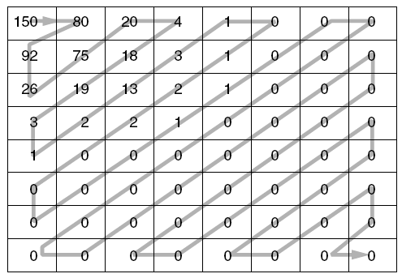
The JPEG Standard (4)
Figure 7-9. The order in which the quantized
values are transmitted.
Tanenbaum, Modern Operating Systems 3 e, (c) 2008 Prentice-Hall, Inc. All rights reserved. 0-13-6006639

Slide 13
The MPEG Standard (1)
Three types of MPEG-2 frames processed by the viewing program:
I (Intracoded) frames: Self-contained JPEG-encoded still pictures.
P (Predictive) frames: Block-by-block difference with the last frame.
B (Bidirectional) frames: Differences with the last and next frame.
Tanenbaum, Modern Operating Systems 3 e, (c) 2008 Prentice-Hall, Inc. All rights reserved. 0-13-6006639

Slide 14
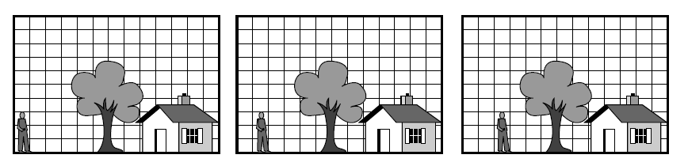
The MPEG Standard (2)
Figure 7-10. Three consecutive video frames.
Tanenbaum, Modern Operating Systems 3 e, (c) 2008 Prentice-Hall, Inc. All rights reserved. 0-13-6006639

Slide 15
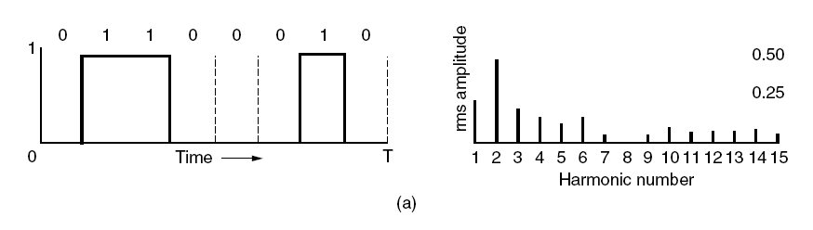
Audio Compression (1)
Figure 7-11. (a) A binary signal and its
root-mean-square Fourier amplitudes.
Tanenbaum, Modern Operating Systems 3 e, (c) 2008 Prentice-Hall, Inc. All rights reserved. 0-13-6006639

Slide 16
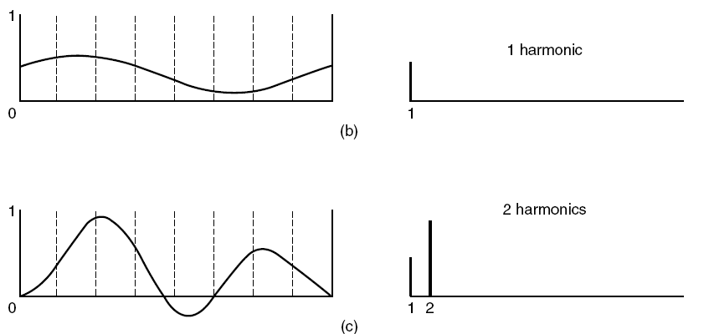
Audio Compression (2)
Figure 7-11. (b)–(e) Successive approximations
to the original signal.
Tanenbaum, Modern Operating Systems 3 e, (c) 2008 Prentice-Hall, Inc. All rights reserved. 0-13-6006639

Slide 17
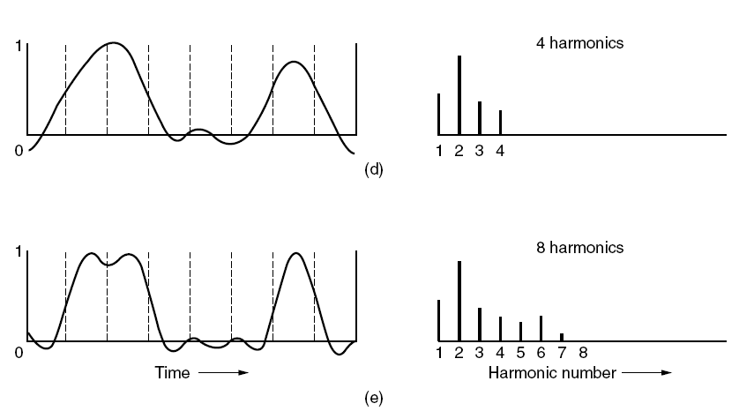
Audio Compression (3)
Figure 7-11. (b)–(e) Successive approximations
to the original signal.
Tanenbaum, Modern Operating Systems 3 e, (c) 2008 Prentice-Hall, Inc. All rights reserved. 0-13-6006639

Slide 18
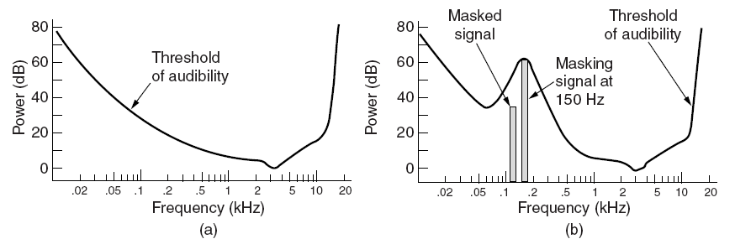
Audio Compression (4)
Figure 7-12. (a) The threshold of audibility as a
function of frequency. (b) The masking effect.
Tanenbaum, Modern Operating Systems 3 e, (c) 2008 Prentice-Hall, Inc. All rights reserved. 0-13-6006639

Slide 19
Audio Compression (5)
Possible sampling configurations:
Monophonic (a single input stream).
Dual monophonic (e.g., an English and a Japanese soundtrack).
Disjoint stereo (each channel compressed separately).
Joint stereo (interchannel redundancy fully exploited).
Tanenbaum, Modern Operating Systems 3 e, (c) 2008 Prentice-Hall, Inc. All rights reserved. 0-13-6006639

Slide 20
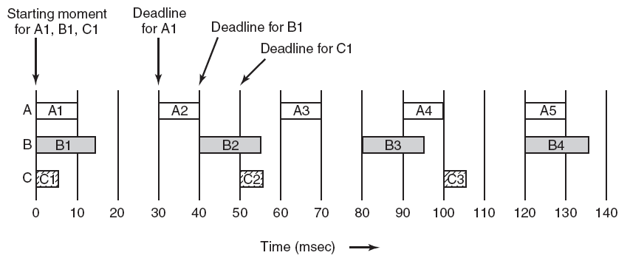
General Real-Time Scheduling
Figure 7-13. Three periodic processes, each displaying a movie. The frame rates and processing requirements per frame are different for each movie.
Tanenbaum, Modern Operating Systems 3 e, (c) 2008 Prentice-Hall, Inc. All rights reserved. 0-13-6006639

Slide 21
Rate Monotonic Scheduling (1)
Required conditions for RMS:
Each periodic process must complete within its period.
No process is dependent on any other process.
Each process needs same amount of CPU time on each burst.
Nonperiodic processes have no deadlines.
Process preemption occurs instantaneously and with no overhead.
Tanenbaum, Modern Operating Systems 3 e, (c) 2008 Prentice-Hall, Inc. All rights reserved. 0-13-6006639

Slide 22
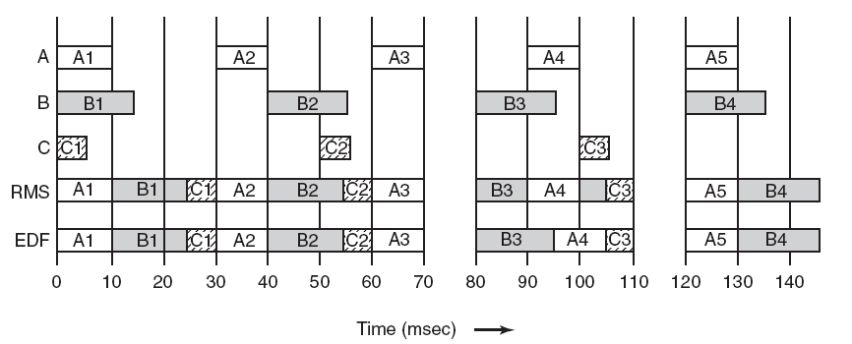
Rate Monotonic Scheduling (2)
Figure 7-14. An example of RMS and EDF real-time scheduling.
Tanenbaum, Modern Operating Systems 3 e, (c) 2008 Prentice-Hall, Inc. All rights reserved. 0-13-6006639

Slide 23
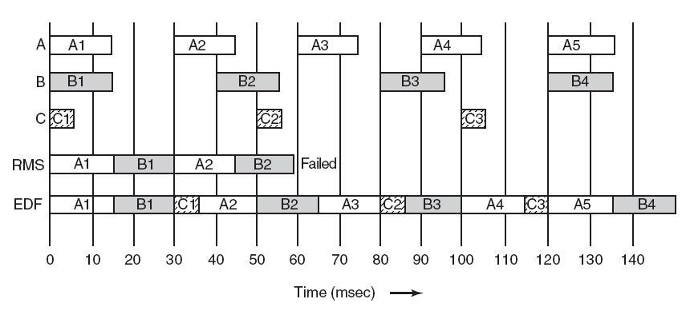
Earliest Deadline First Scheduling
Figure 7-15. Another example of real-time
scheduling with RMS and EDF.
Tanenbaum, Modern Operating Systems 3 e, (c) 2008 Prentice-Hall, Inc. All rights reserved. 0-13-6006639

Slide 24
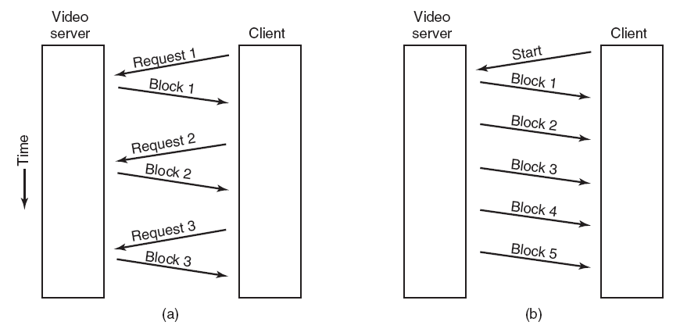
Multimedia File System Paradigms
Figure 7-16. (a) A pull server. (b) A push server.
Tanenbaum, Modern Operating Systems 3 e, (c) 2008 Prentice-Hall, Inc. All rights reserved. 0-13-6006639

Slide 25
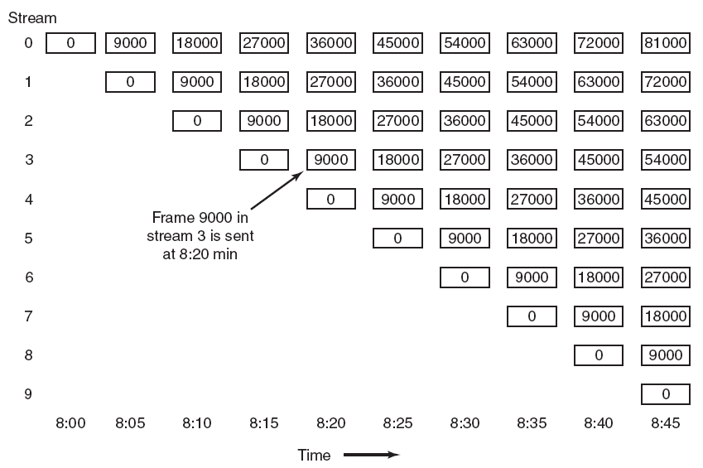
Near Video on Demand
Figure 7-17. Near video on demand has a new stream
starting at regular intervals, in this example
every 5 minutes (9000 frames).
Tanenbaum, Modern Operating Systems 3 e, (c) 2008 Prentice-Hall, Inc. All rights reserved. 0-13-6006639

Slide 26
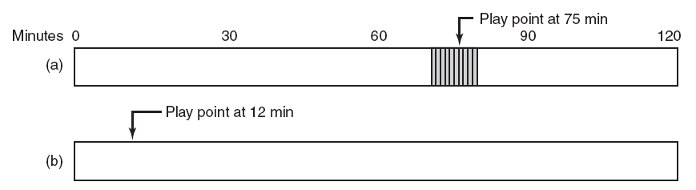
Near Video on Demand with VCR Functions (1)
Figure 7-18. (a) Initial situation. (b) After a rewind to 12 min
Tanenbaum, Modern Operating Systems 3 e, (c) 2008 Prentice-Hall, Inc. All rights reserved. 0-13-6006639

Slide 27
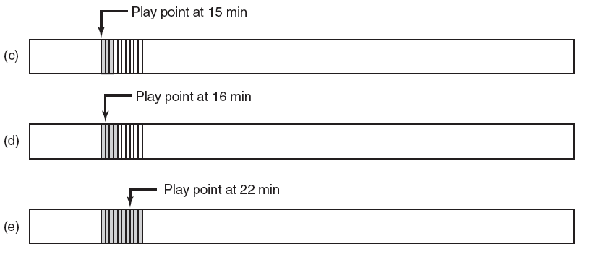
Near Video on Demand with VCR Functions (2)
Figure 7-18. (c) After waiting 3 min.
(d) After starting to refill the buffer. (e) Buffer full.
Tanenbaum, Modern Operating Systems 3 e, (c) 2008 Prentice-Hall, Inc. All rights reserved. 0-13-6006639

Slide 28
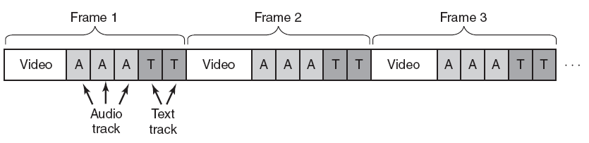
Placing a File on a Single Disk
Figure 7-19. Interleaving video, audio, and text in a single contiguous file per movie.
Tanenbaum, Modern Operating Systems 3 e, (c) 2008 Prentice-Hall, Inc. All rights reserved. 0-13-6006639

Slide 29
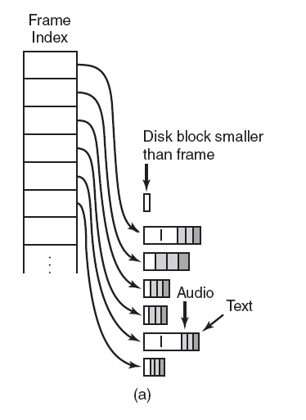
Two Alternative File Organization
Strategies (1)
Figure 7-20. Noncontiguous movie storage. (a) Small disk blocks.
Tanenbaum, Modern Operating Systems 3 e, (c) 2008 Prentice-Hall, Inc. All rights reserved. 0-13-6006639

Slide 30
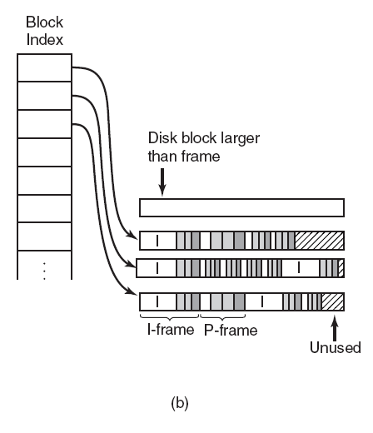
Two Alternative File Organization
Strategies (2)
Figure 7-20. Noncontiguous movie storage
(b) Large disk blocks.
Tanenbaum, Modern Operating Systems 3 e, (c) 2008 Prentice-Hall, Inc. All rights reserved. 0-13-6006639

Slide 31
Two Alternative File Organization
Strategies (3)
Trade-offs involved in these alternatives:
Frame index: Heavier RAM usage while movie is playing; little disk wastage.
Block index (no splitting frames over blocks): Low RAM usage; major disk wastage.
Block index (splitting frames over blocks is allowed): Low RAM usage; no disk wastage; extra seeks.
Tanenbaum, Modern Operating Systems 3 e, (c) 2008 Prentice-Hall, Inc. All rights reserved. 0-13-6006639

Slide 32
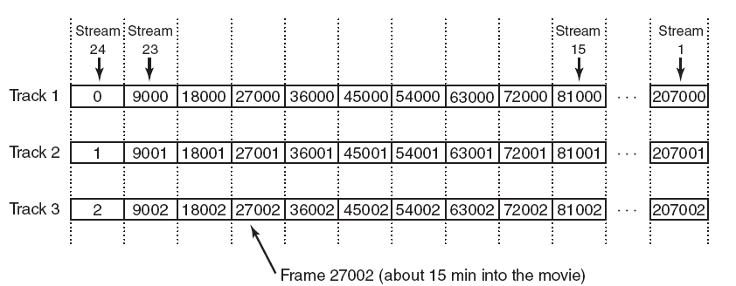
Placing Files for Near Video on Demand
Figure 7-21. Optimal frame placement for near video on demand.
Tanenbaum, Modern Operating Systems 3 e, (c) 2008 Prentice-Hall, Inc. All rights reserved. 0-13-6006639

Slide 33
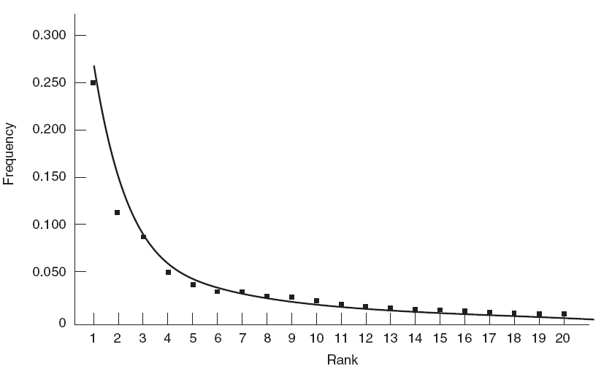
Placing Multiple Files on a Single Disk (1)
Figure 7-22. The curve gives Zipf’s law for N = 20. The
squares represent the populations of the 20
largest cities in the U.S., sorted on rank order
(New York is 1, Los Angeles is 2, Chicago is 3, etc.).
Tanenbaum, Modern Operating Systems 3 e, (c) 2008 Prentice-Hall, Inc. All rights reserved. 0-13-6006639

Slide 34
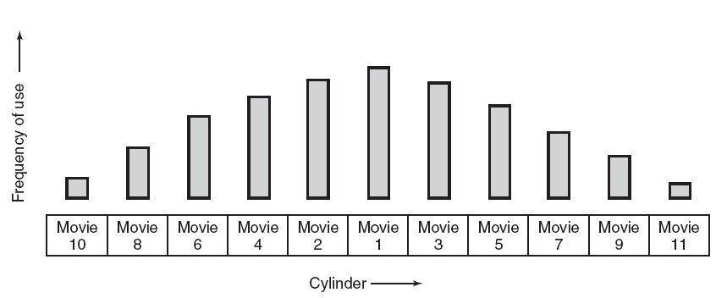
Placing Multiple Files on a Single Disk (2)
Figure 7-23. The organ-pipe distribution of files on a video server.
Tanenbaum, Modern Operating Systems 3 e, (c) 2008 Prentice-Hall, Inc. All rights reserved. 0-13-6006639

Slide 35
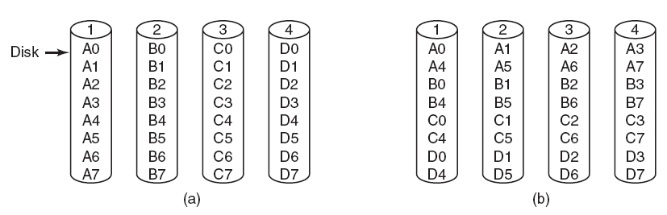
Placing Files on Multiple Disks (1)
Figure 7-24. Four ways of organizing multimedia files over multiple disks. (a) No striping. (b) Same striping all files.
Tanenbaum, Modern Operating Systems 3 e, (c) 2008 Prentice-Hall, Inc. All rights reserved. 0-13-6006639

Slide 36
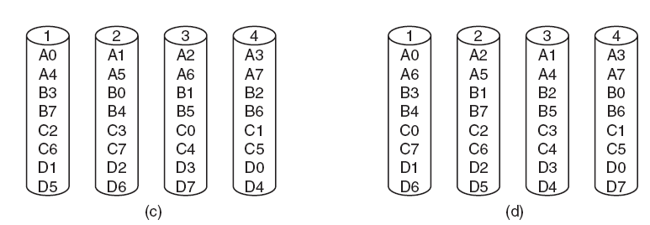
Placing Files on Multiple Disks (2)
Figure 7-24. Four ways of organizing multimedia files over multiple disks. (c) Staggered striping. (d) Random striping.
Tanenbaum, Modern Operating Systems 3 e, (c) 2008 Prentice-Hall, Inc. All rights reserved. 0-13-6006639

Slide 37
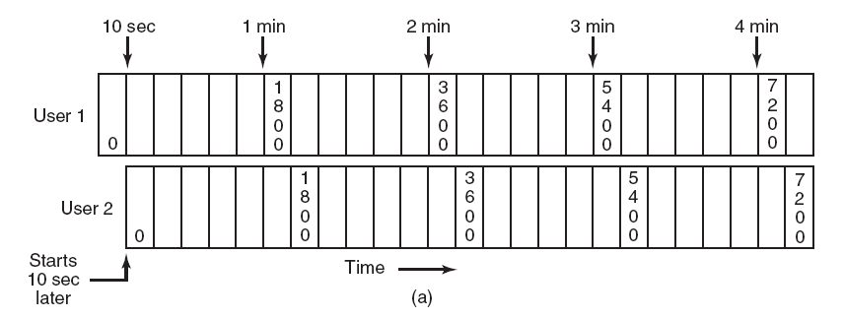
Block Caching (1)
Figure 7-25. (a) Two users watching the same
movie 10 sec out of sync.
Tanenbaum, Modern Operating Systems 3 e, (c) 2008 Prentice-Hall, Inc. All rights reserved. 0-13-6006639

Slide 38
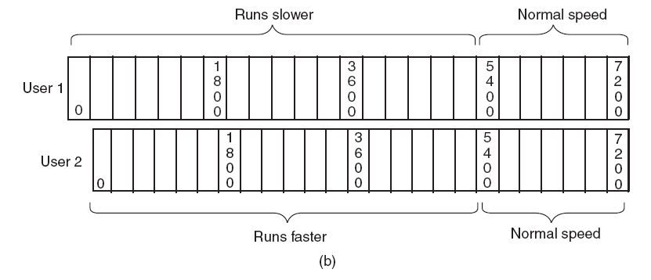
Block Caching (2)
Figure 7-25. (b) Merging the two streams into one.
Tanenbaum, Modern Operating Systems 3 e, (c) 2008 Prentice-Hall, Inc. All rights reserved. 0-13-6006639

Slide 39
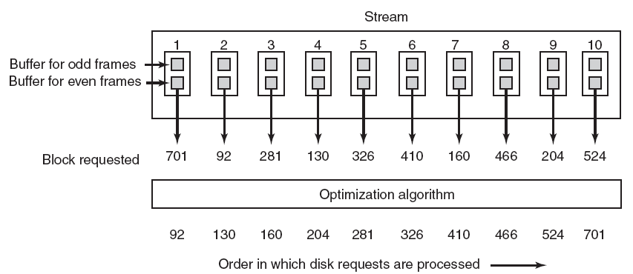
Static Disk Scheduling
Figure 7-26. In one round, each movie asks for one frame.
Tanenbaum, Modern Operating Systems 3 e, (c) 2008 Prentice-Hall, Inc. All rights reserved. 0-13-6006639

Slide 40
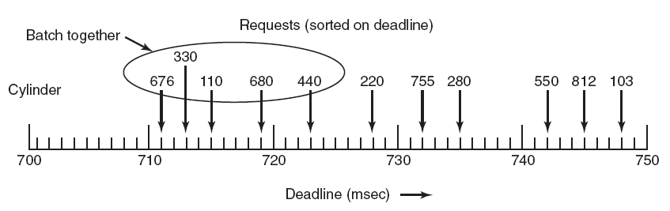
Dynamic Disk Scheduling
Figure 7-27. The scan-EDF algorithm uses deadlines and cylinder numbers for scheduling.
Tanenbaum, Modern Operating Systems 3 e, (c) 2008 Prentice-Hall, Inc. All rights reserved. 0-13-6006639

